Slide 1
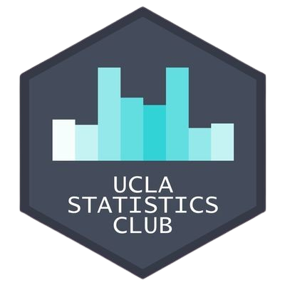
Intro to SQL Workshop
Annabelle Lee & Jessica Ye

Slide 2


About the Presenters
Annabelle Lee
Jessica Ye
Workshop Co-Chair
Data Theory Major
Workshop Intern
Data Theory Major
Follow along with our slides: https://bit.ly/3Gye9lV

Slide 3
Table of Contents
01
SQL Intro/Overview
What is SQL? What is it used for?
02
Beginner Terms
SELECT, FROM, ORDER BY, GROUP BY, HAVING, etc.
03
Intermediate Terms
Window Functions, CTE’s, subqueries, COALESCE
04
More than one table
LEFT JOIN, INNER JOIN
Follow along with our slides: https://bit.ly/3Gye9lV

Slide 4
What is SQL?
Follow along with our slides: https://bit.ly/3Gye9lV
Notes:
what does SQL stand for? make someone answer this question (if no one knows say “someone google it, youll get candy”)

Slide 5

Introduction
SQL stands for Structured Query Language, and it's designed for managing and interacting with structured data — that is, data organized in clearly defined relationships, like rows and columns in relational tables.
Structured: SQL is built for working with structured data, typically stored in relational tables — similar to data frames in R.
Query: It allows you to query, update, and manipulate data efficiently, whether you're filtering rows, joining tables, or aggregating values.
Language: SQL uses a clear, keyword-driven syntax, making it a powerful and readable tool for data analysis and database management.
Follow along with our slides: https://bit.ly/3Gye9lV

Slide 6
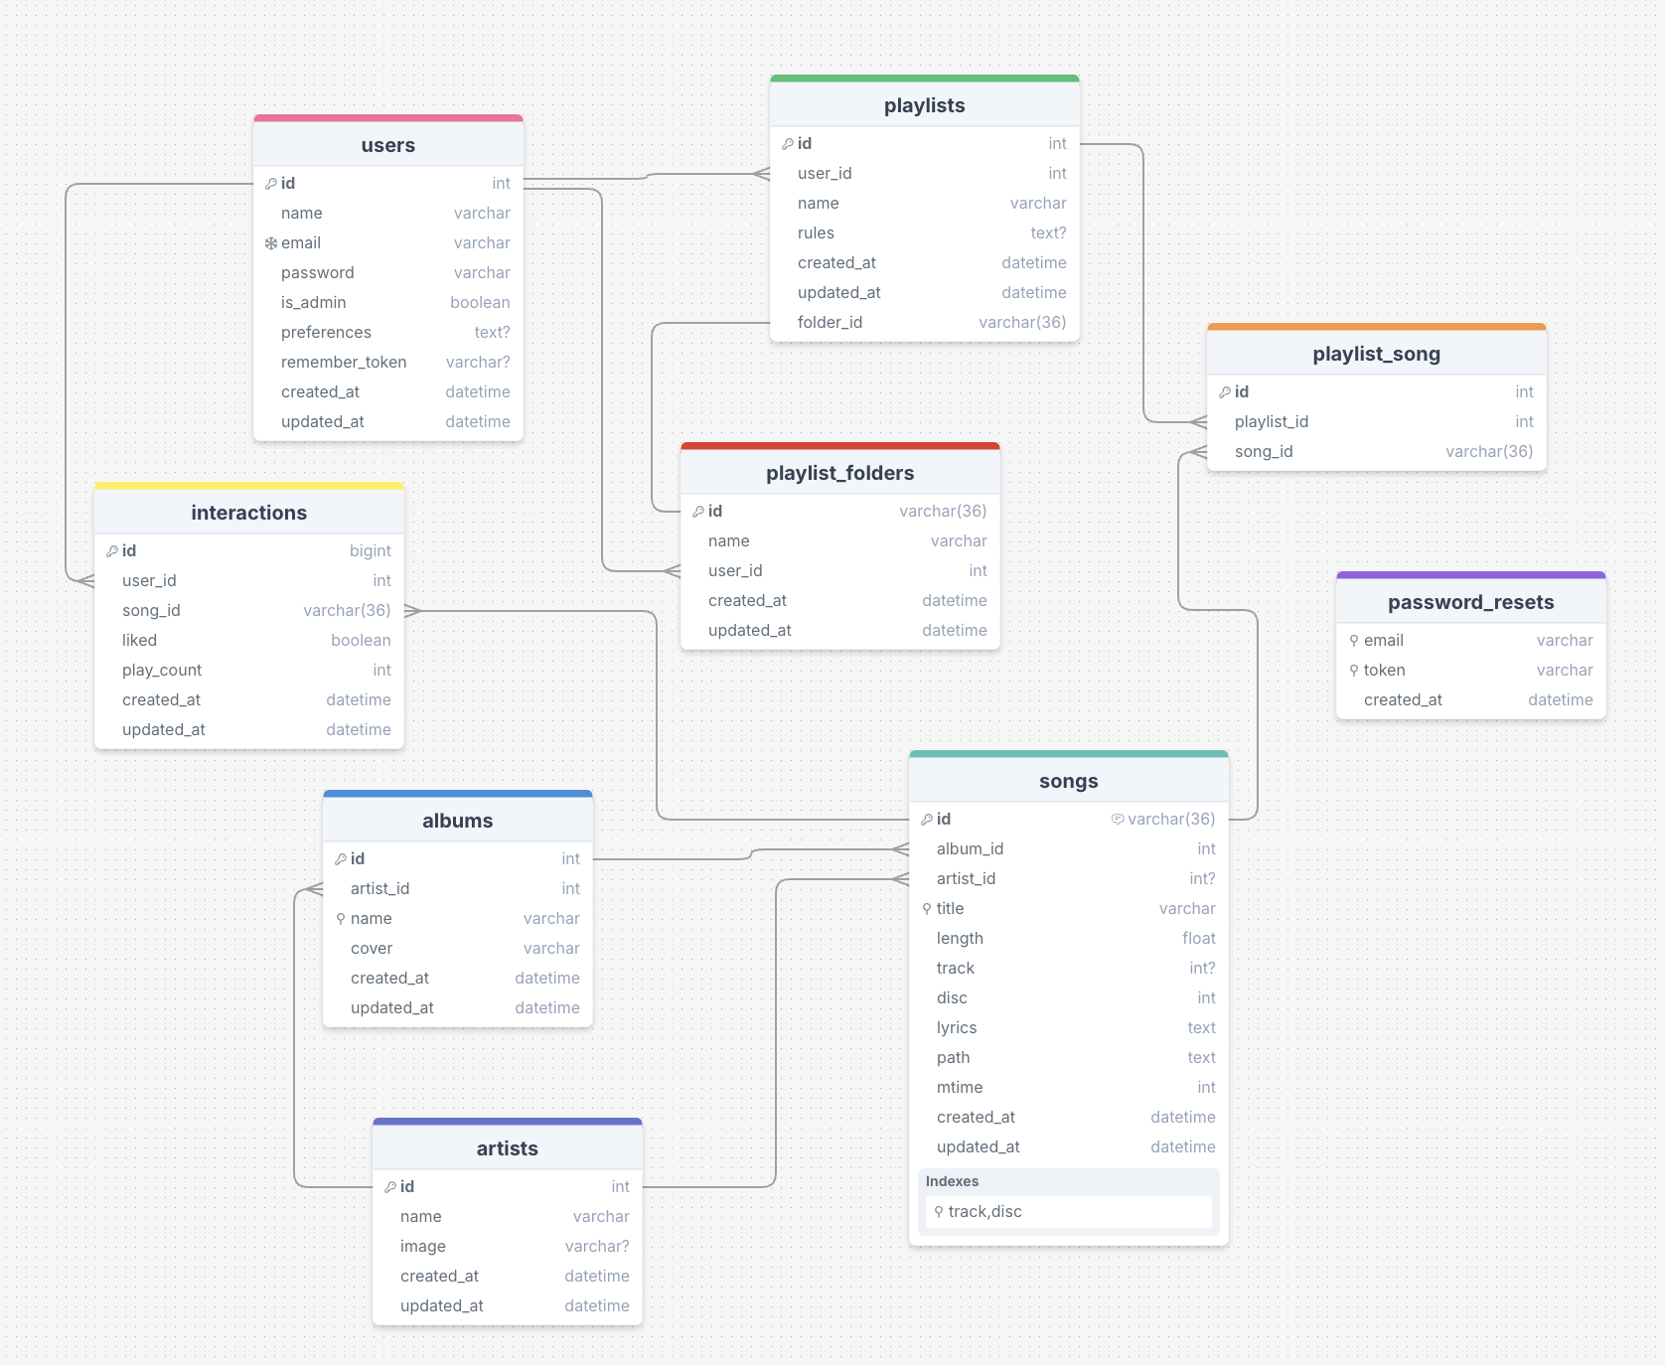
Structure of SQL Database
A SQL database consists of several tables
Think of the tables as nodes in a network.
Follow along with our slides: https://bit.ly/3Gye9lV
Notes:
possible question: can someone, just based off the picture, see what’s different from SQL tables and R dataframes? (they’re relational/connected)

Slide 7
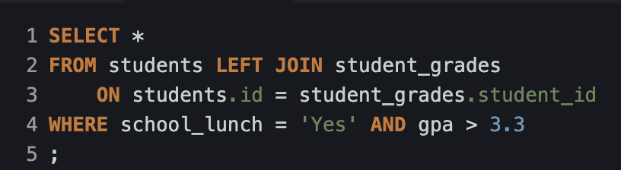

Querying in SQL
statements/clauses to read or mutate the database
Analogy:
SQL tables ~ R data.frame
SQL query ~ R code to filter, group, and summarize a dataset
Follow along with our slides: https://bit.ly/3Gye9lV

Slide 8
Instructions
Link to these slides: https://bit.ly/3Gye9lV
Go to: https://sqliteonline.com/
Copy paste the code from here to get our demo data:
https://tinyurl.com/2uwcpw5v
Follow along with our slides: https://bit.ly/3Gye9lV

Slide 9
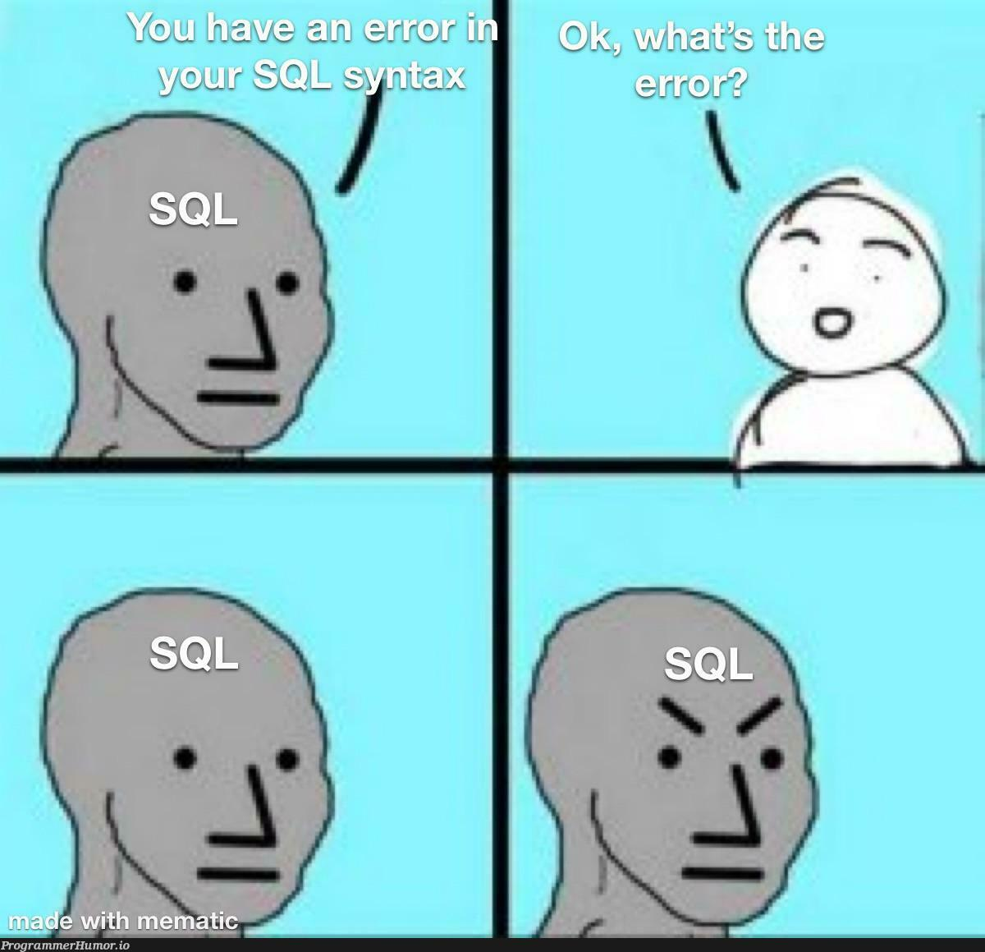
Challenge!
SELECT grade_level, AVG(gpa) AS avg_gpa
FROM students
WHERE school_lunch = 'Yes'
GROUP BY grade_level
HAVING avg_gpa > 3.0
ORDER BY avg_gpa DESC;
Follow along with our slides: https://bit.ly/3Gye9lV

Slide 10
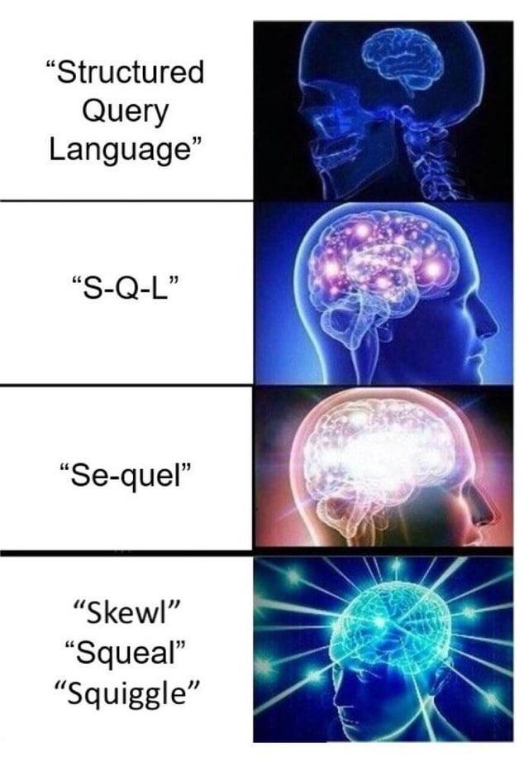
Challenge!
SELECT grade_level, COUNT(*)
FROM students
WHERE school_lunch = 'Yes'
GROUP BY grade_level
HAVING COUNT(*) >= 5;
Follow along with our slides: https://bit.ly/3Gye9lV

Slide 11

SELECT: chooses columns
FROM: specifies the table
WHERE: filters rows
GROUP BY: groups rows
HAVING: filters those groups
ORDER BY: sorts results
LIMIT: controls output size
DISTINCT: removes duplicates
Quick Summary

Slide 12
Window Functions!
What if we wanted to get class rankings per grade? Ex. rank people by gpa within their grade
Get the table with student name and gpa, ordered by descending GPA
Get the row number, coupled with over clause
What do we want to be looking at when assigning row numbers?
Get the row number over the descending GPA (this is our window function)
What about people with the same GPA?
Partition by grade level
Follow along with our slides: https://bit.ly/3Gye9lV

Slide 13
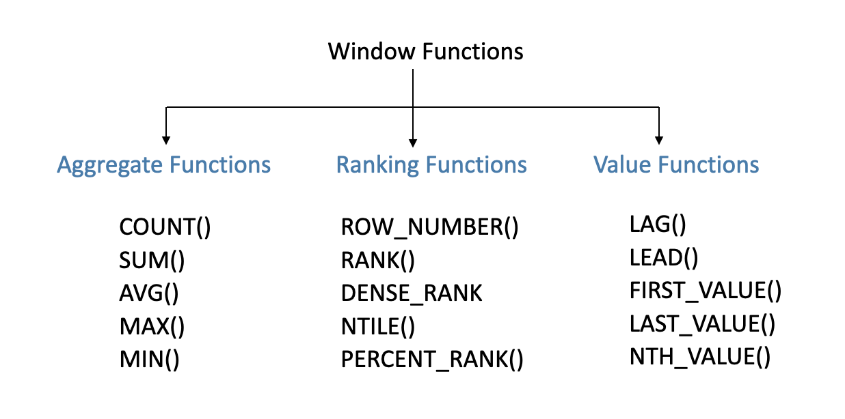
Window Functions!
Follow along with our slides: https://bit.ly/3Gye9lV

Slide 14
Subqueries and CTE’s
Challenge: What are the top 2 students in each grade?
We want to use the table we found earlier, with the student, grade level, gpa, and rankings column
subquery: query inside a query
does not have to be named
defined inline
CTE: using the WITH clause
defined at the top
can be used recursively
Follow along with our slides: https://bit.ly/3Gye9lV

Slide 15

Problem: Noah Scott is missing his GPA (a tragedy)
Follow along with our slides: https://bit.ly/3Gye9lV

Slide 16
COALESCE Function
Get the table with student name and gpa
Fill in using COALESCE with 0
Fill in with average gpa, using a subquery
Fill in with average gpa of grade level
Get our grade level/gpa table, and save as CTE
Take average gpa from grade level table when the grade level matches
Charge Noah Scott for our efforts
Follow along with our slides: https://bit.ly/3Gye9lV

Slide 17
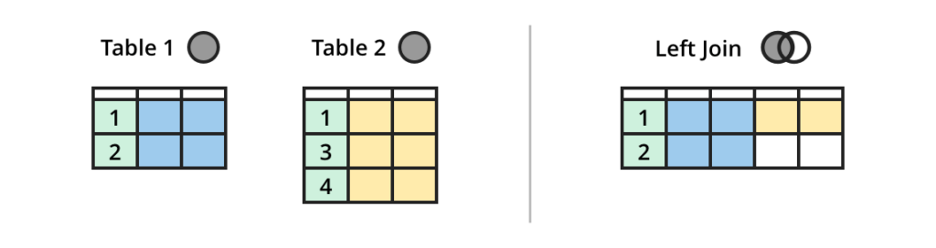
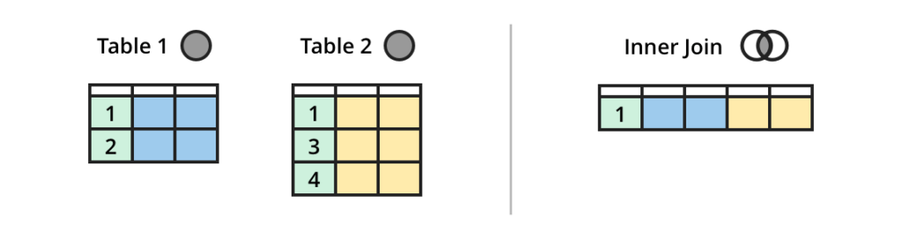
Joining multiple tables together
LEFT JOIN vs. INNER JOIN:
left join matches together, even if there are no matching rows
inner join only does matching rows
In our data, we can see that Noah Scott disappears with INNER JOIN
Follow along with our slides: https://bit.ly/3Gye9lV

Slide 18

FINAL CHALLENGE:
Follow along with our slides: https://bit.ly/3Gye9lV

Slide 19
FINAL CHALLENGE:
In which classes do girls have a higher final average grade than boys?
Follow along with our slides: https://bit.ly/3Gye9lV

Slide 20
Final Challenge:
Get the table with the average final grade per class, per gender
Save as CTE
Get the highest average final grade for each class
Filter by gender
Follow along with our slides: https://bit.ly/3Gye9lV

Slide 21
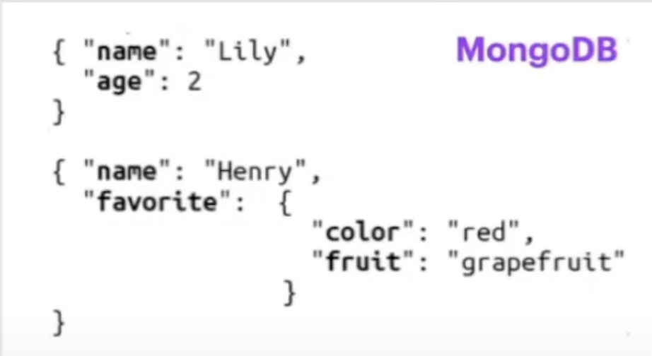
SQL vs. NoSQL
NoSQL: Not Only SQL
SQL requires predefined schema
NoSQL refers to non-relational database (dynamic schema)
Predefined Schema:
Dynamic Schema:
Name | Fav. Color | Age
John | Blue | 42
Abigail | Red | 16
Follow along with our slides: https://bit.ly/3Gye9lV

Slide 22
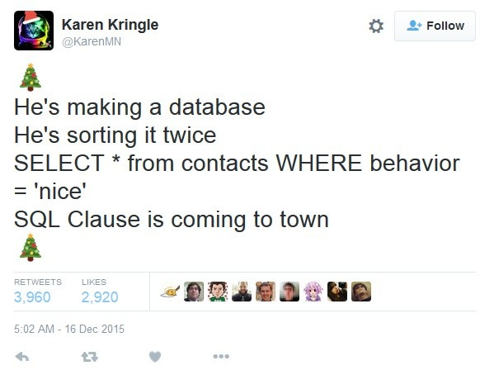
Want more SQL?
STATS 167 (new course this quarter!)
SQL UCLA Extension course: https://www.uclaextension.edu/digital-technology/software-development-programming/course/introduction-sql-com-sci-x-41461
Good YT channel with SQL tutorials: https://www.youtube.com/@MavenAnalytics
If you want to look back on our code today: https://docs.google.com/document/d/1KIK-QIw-bZy0qAX_RgbigU_xr9z_AvYuNWA1G33BDoM/edit?usp=sharing

